Slide 1
DUBE TRADEPORT
Focus on AgriZone
DAEA TIKZN EXPORT WORKSHOP
27 March 2014

Slide 2
WHO IS DUBE TRADEPORT?
Comprised of
  A legislated government entity, Dube TradePort Corporation (DTPC)
  And the brand and precinct, Dube TradePort (DTP)
Southern Africa’s premier air logistics platform
Home of King Shaka International Airport (KSIA)
Built around a 60-year masterplan, which utilises a 2 040 ha greenfield site
The first phase has been completed by the KZN provincial Government and ACSA, with an investment of R8 billion

Slide 3
MAIN DEVELOPMENT ZONES
DUBE CARGO TERMINAL
  Most secure and state-of-the-art cargo terminal in Africa
DUBE TRADEZONE
  Directly linked to the Cargo Terminal by airbridge, with airside access to manufacturers, assemblers and distributors
DUBE CITY
  Premium office, retail, hospitality and leisure space in an urban green precinct
DUBE AGRIZONE
  Africa’s first integrated perishable supply chain; a high-tech agricultural cluster including 16 ha of climate-controlled greenhouses, packhouses and a tissue culture lab

Slide 4
SUPPORT SERVICES
DUBE iCONNECT
  A dedicated IT and tele-communications provider, supporting and linking Dube TradePort’s business community
DUBE AiROAD
  A dedicated, time-sensitive logistics fleet connecting the Cargo Terminal to major cities and airports in Southern Africa
DUBE AIR SERVICES
  Working to significantly increase direct international and regional air services to and from Durban
DUBE PLANNING & ENVIRONMENT
  Working towards DTP’s 60-year masterplan, and committed to minimising environmental impact

Slide 5
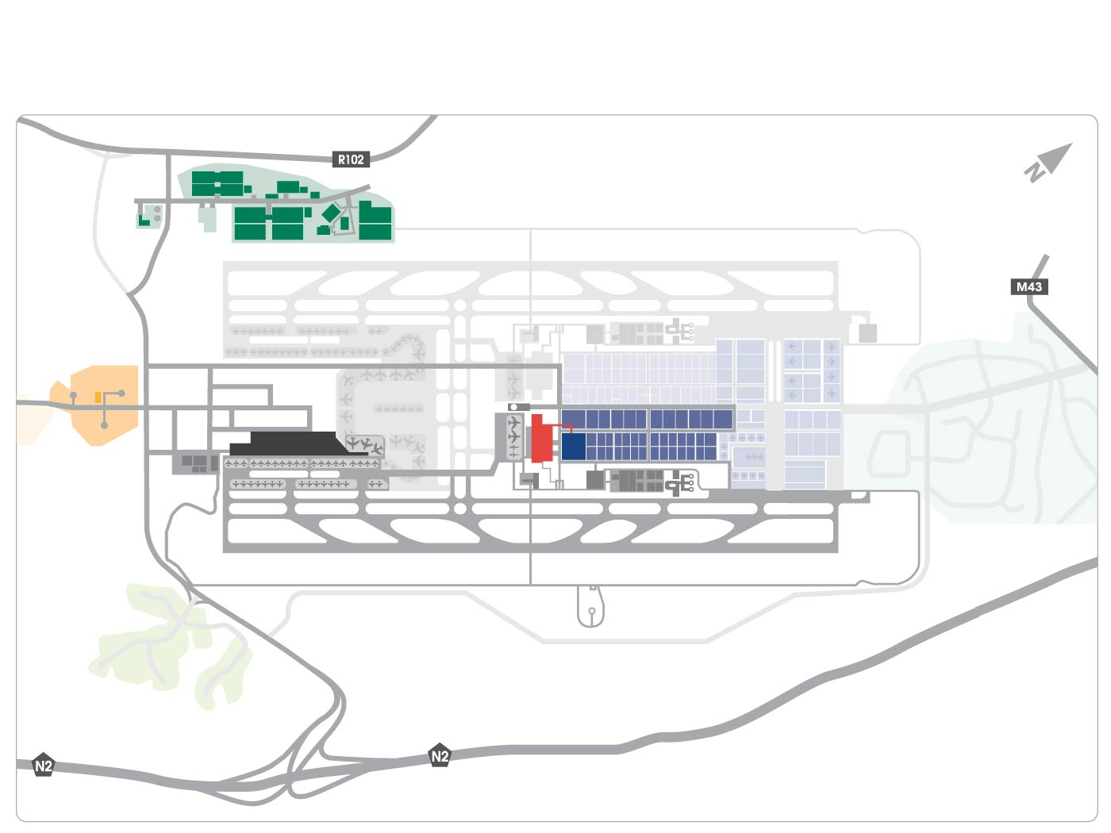
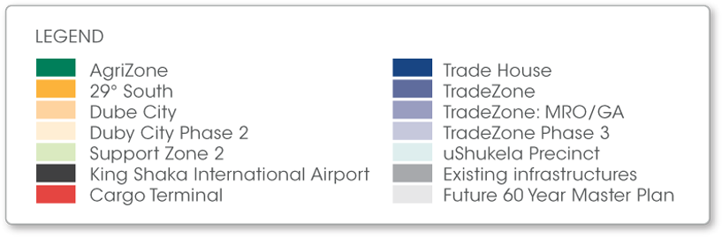
MASTERPLAN

Slide 6
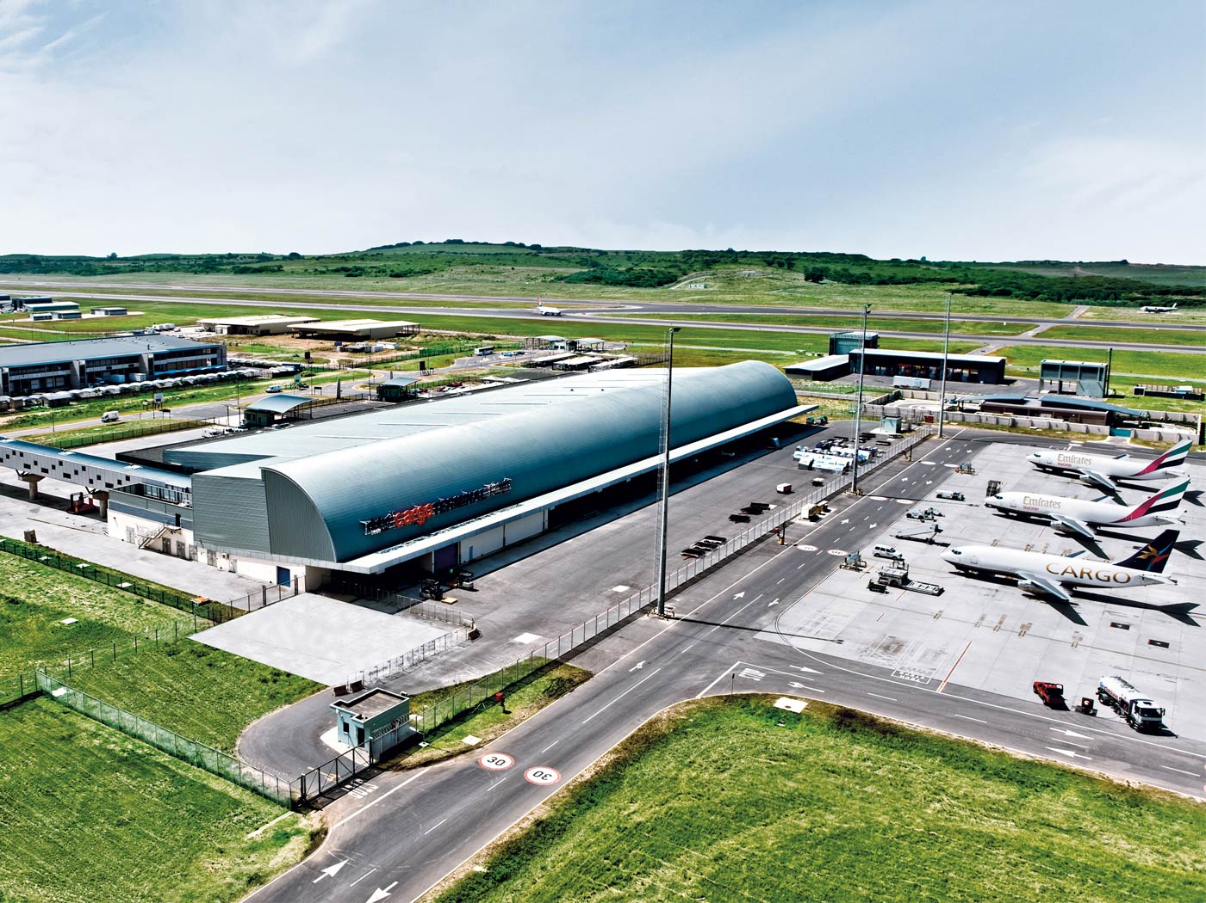
DUBE CARGO TERMINAL

Slide 7
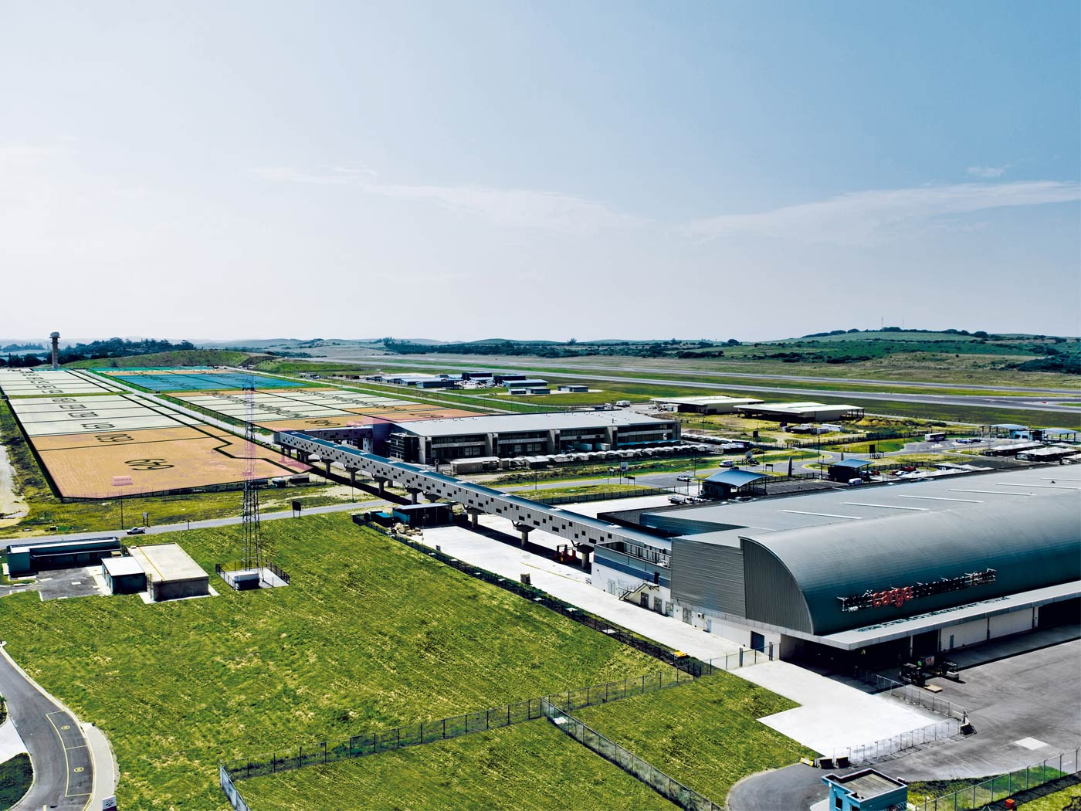
DUBE TRADEZONE & DUBE CARGO TERMINAL
Connected by Air Bridge

Slide 8
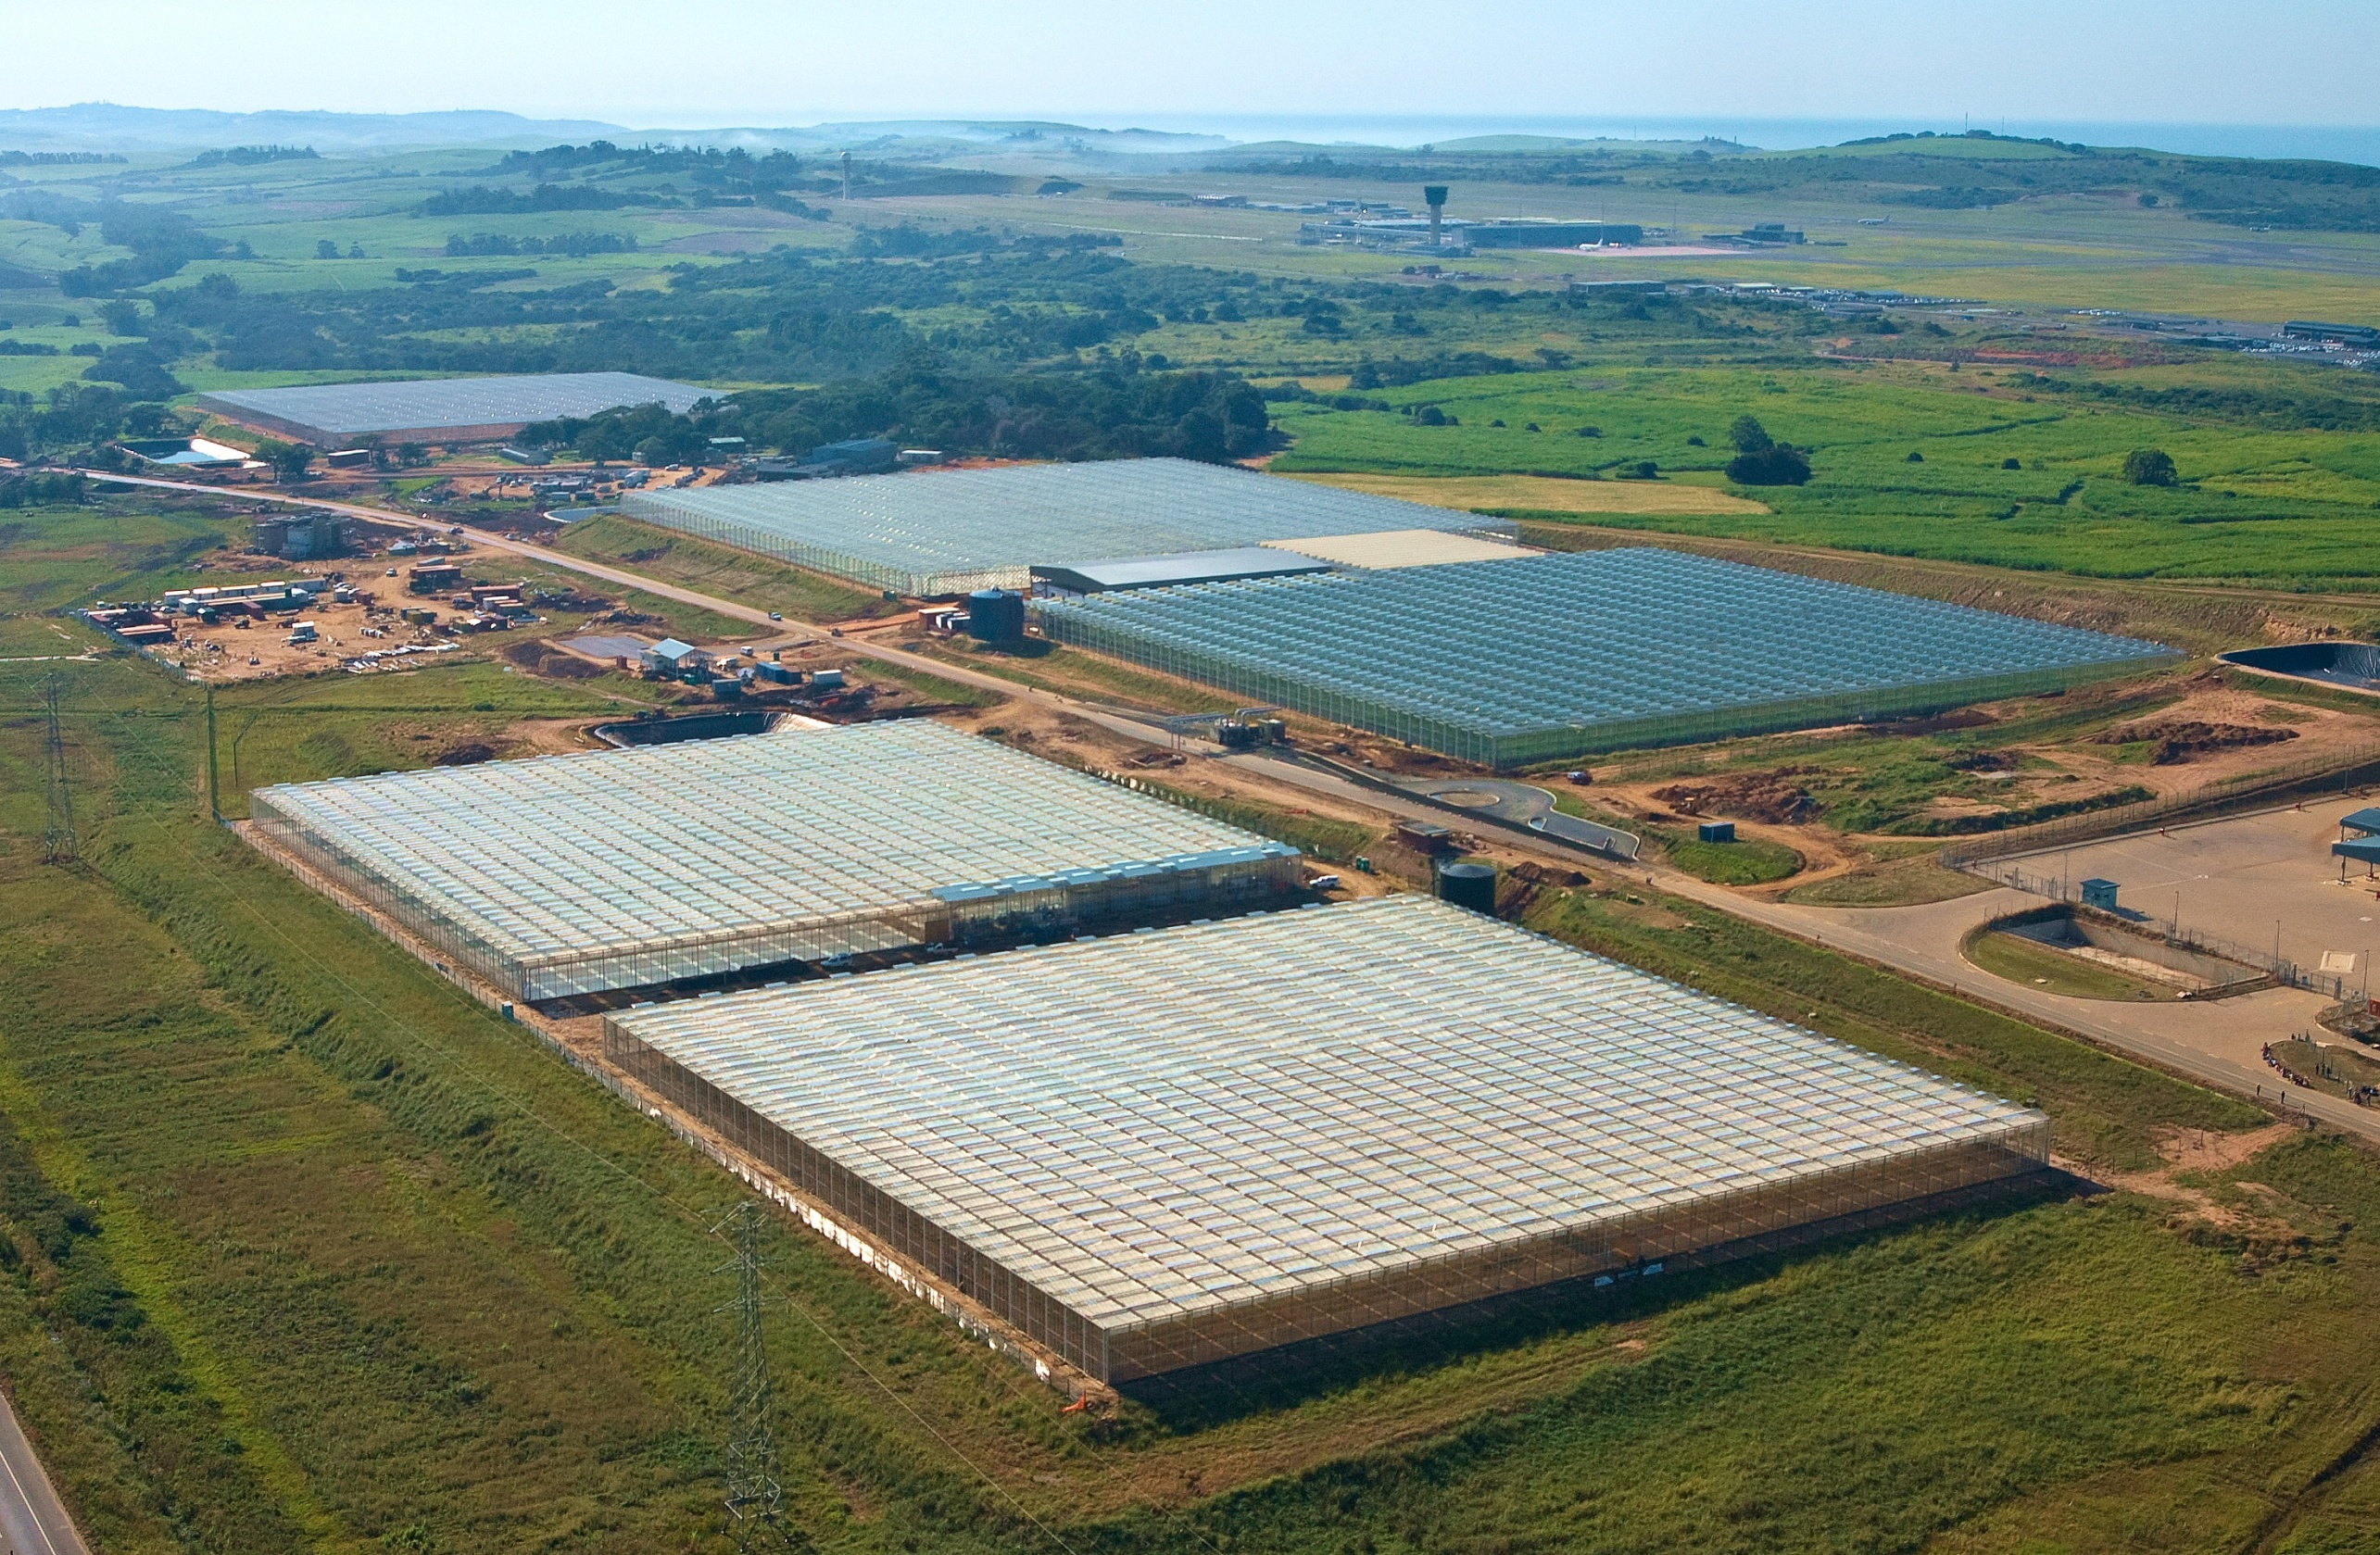
AGRIZONE: PHASE 1 VIEW

Slide 9
OBJECTIVES OF THE PROJECT
Create a cluster of supporting facilities and services (production, research & development, logistics, information, certification, marketing, etc) to stimulate the growth of the KZN perishables sector.
Serve as a centre of excellence and a demonstration project for new technology, production methods, training, research in high value agriculture.
Stimulate & contribute to a move towards more high value production in the province.
To act as an incubator for new producers by providing training, mentoring, technical assistance and other support services.
Maximise the location opportunity presented by close proximity to the airport to stimulate air freight exports.

Slide 10
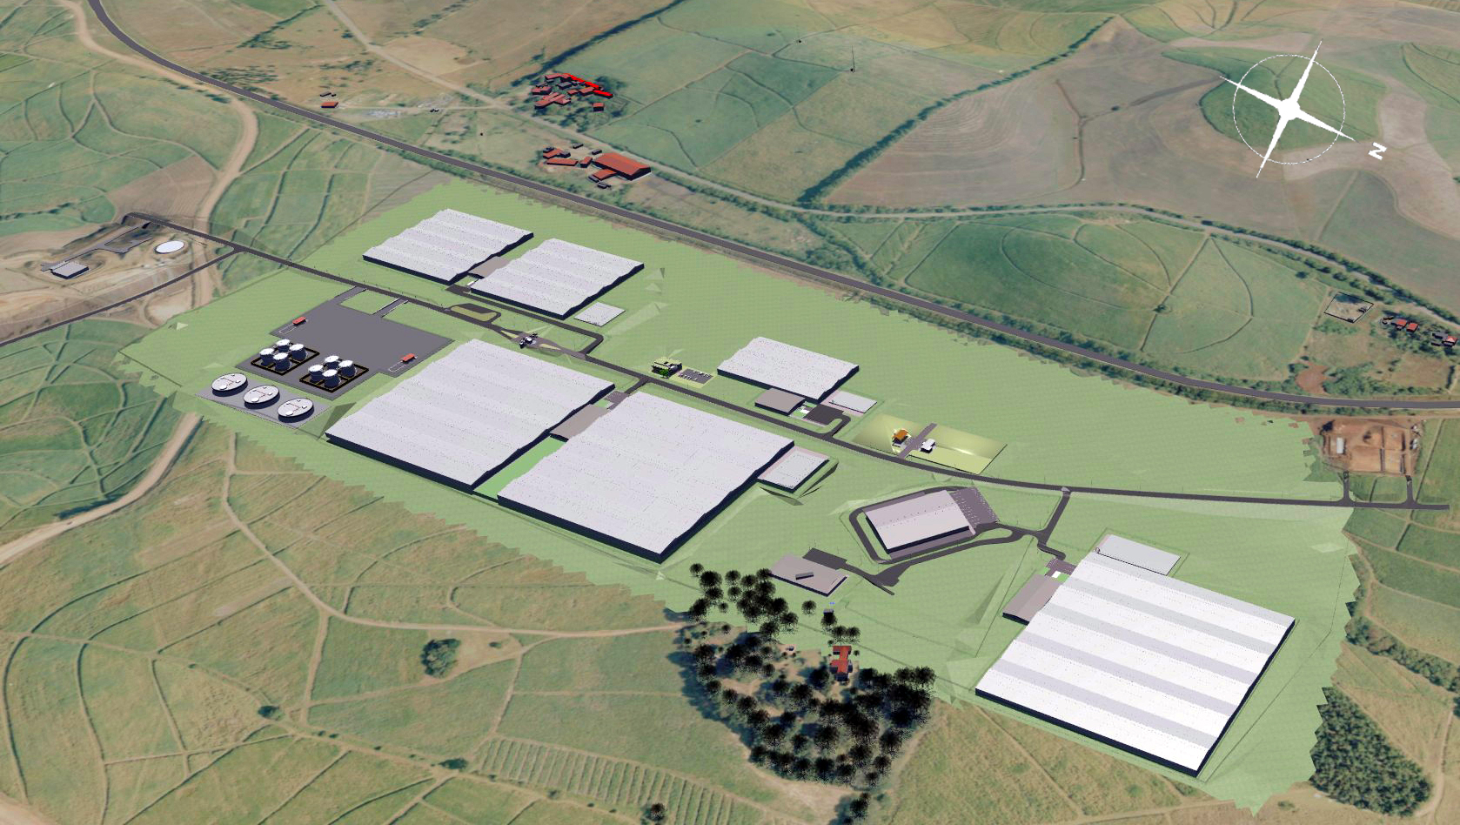
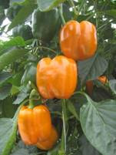
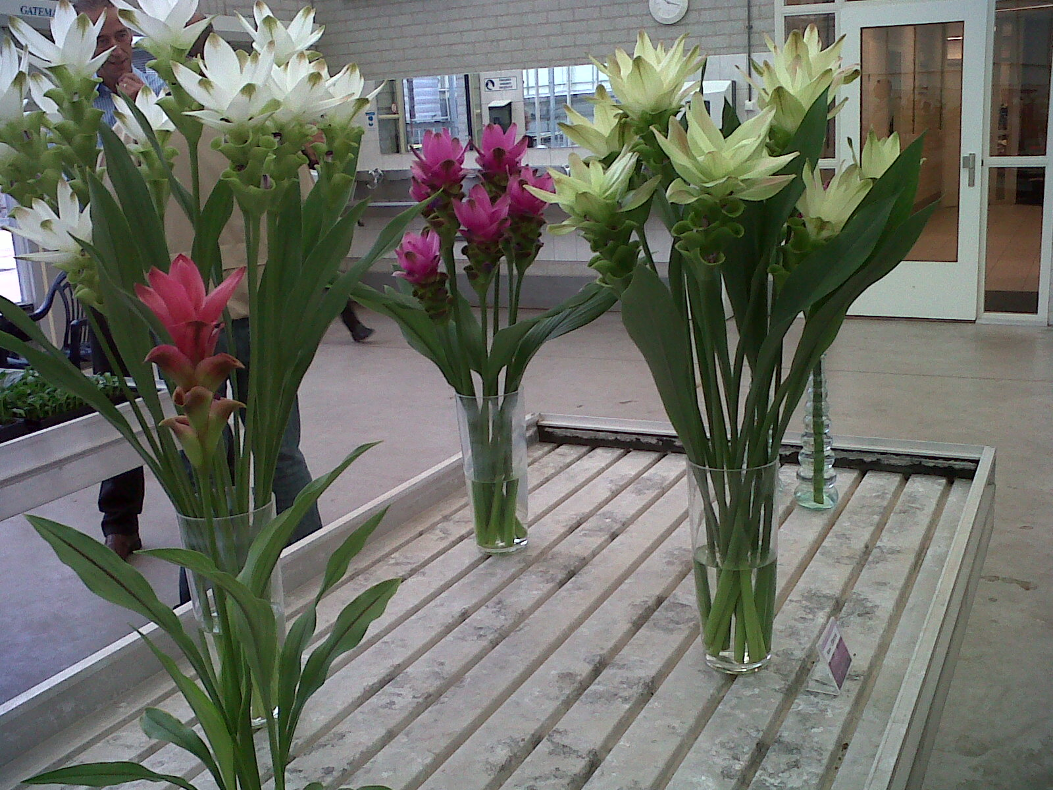
GLOBAL & LOCAL CONTEXT
Urbanisation – more people in urban areas than any period in history
Population growth – More than 6 billion people and projected to grow even further
Number of farmers and area under farmland decreasing as countries develop
Increased demands by consumers (quality, seasonality, etc)
Higher Energy costs
Water scarcity
Focus on Global warming and CO2 emissions
Notes:
Trends or drivers that underpin the development
1980 there had been around 128 000 commercial farmers, which had dropped to 58 000 in 1997 and to just under 40 000 today. Predictions were that this would drop to 15 000 in the next 15 years.

Slide 11
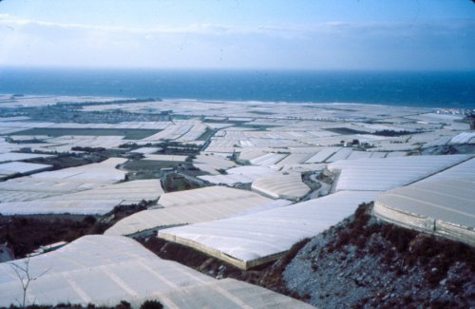
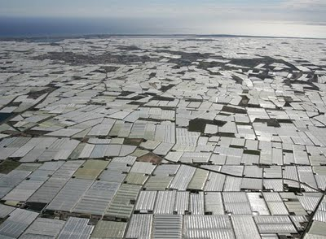
RESPONSES – INTENSIVE PRODUCTION METHODS
ADVANTAGES OF PROTECTED
AGRICULTURE
Better Yields - High Value and High Quality Production
Year round growth
Better control of Pests and Diseases – also eliminates possibility of getting soil based pathogens
Higher productivity and better utilisation of space
Minimize Risk – Stabilize Production
Better water utilization
As a result, area under GH has grown significantly in SA & world wide

Slide 12
AGRIZONE PHASE 1 OVERVIEW
Land extent approximately 64Ha
First phase – 18 Ha under climate controlled greenhouses
Crops for cultivation:
  Cut Flowers and pot plants (curcuma,pot roses, Kalenchoe, Azaleas)
  Vegetables (cherry & standard tomatoes, cucumbers and sweet peppers)
2 Packhouses
Fresh Produce value adding and distribution Centre
Tissue Culture facility
Nursery , alien clearing and rehab programme
Support infrastructure and facilities - water treatment and storage, solar panels, canteen, offices, etc
Notes:
Create a cluster of value chain activities. From farm to fork. So we produce mother stock, grow the crops, pack here , transport
We invest in infrastructure – private sector does operations.
The reasons for greenhouses is to minimise env ipact, by using less land and water, have good quality products and ultimately good prices.
So we have flowers and veggies. You will see the veggies. A bit more on the flowers. Main crop is curcuma. It is native to Thailand. Tropical crop. Thai tulip.
Not in SA. Plant breeder rights owned by KP Holland.
Export strategy to generate frieght for cargo terminal through this.
Model that can be expanded elsewhere.

Slide 13
OPERATIONAL MODEL
DTP functions as the AgriZone operator & landlord and responsible for:
  Overall maintenance of key facilities and irrigation infrastructure
  Running common facilities
  Running a Development programme (including training, market development & empowerment)
Growers / facility operators are tenants and responsible for:
  Managing and maintaining infrastructure within greenhouses & packhouses
  Employing workers within the enterprises
  Day to day operations

Slide 14
CHALLENGES
High Freight rates – number of carriers, distance to markets, oil prices, etc

Slide 15
CHALLENGES
Exchange rate fluctuations
Competition (regional and international)
Protectionism – direct and indirect ( tariffs and non tariff barriers such as “food miles”, local buying and strict phyto sanitary standards)
Agribusiness sector decline (local market conditions, number of new entrants vs leaving, ect)
Different levels of power in the value chain (price setting, cut throat retain competition, retailer standards, etc )

Slide 16
CHALLENGES
Level of support to sector
Notes:
high support for sugar (above average support also for milk and sheep meat).
We don’t support our agribusiness sector the same way that our peers do. There are huge subsides in other countreiws (US =20 Billion USD) . We give some support but largely to sugar. Not in any high value segments. Our support is even lower given that the bulk of that was for land reform projects i.e. purchasing farms.
The reduction of support came in the mind 1990s when most Agricultural Marketing Boards were abolished, import tariffs reduced or eliminated and export subsidies discontinued
If the country is serious about increasing agricultural exports, more support must be given to producers.

Slide 17
CHALLENGES
Stage of development (hence phased development approach)

Slide 18
OPPORTUNITIES & INTERVENTIONS
African market with some air linkages established already - (growing middle class, changing consumer patterns, SA retailer presence, different standards, etc)
Supportive policy environment e.g. National Development Plan
SEZ programme will reduce cost of doing business e.g. trough tax incentives
Air services strategy to attract airlines and create competition which can lead to reduced prices

Slide 19
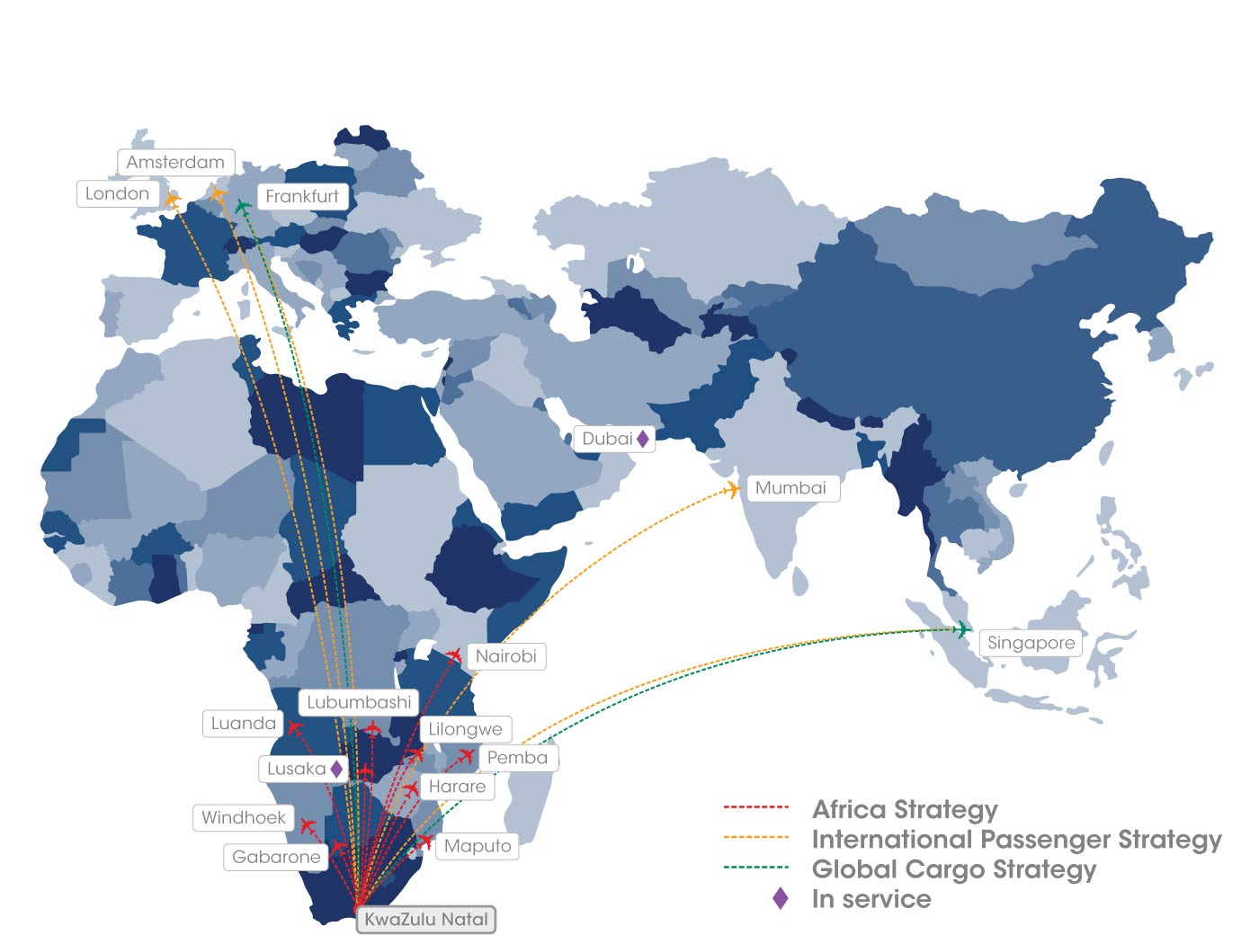
DUBE AIR SERVICES ROUTES

Slide 20
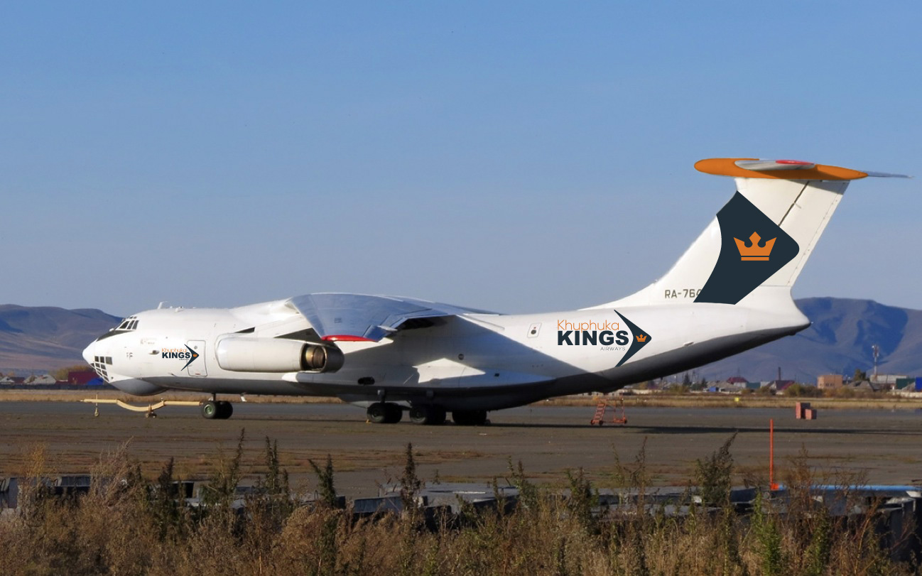
New Route Into Africa: Khuphuka Kings Airways
ILYUSHIN 76

Slide 21
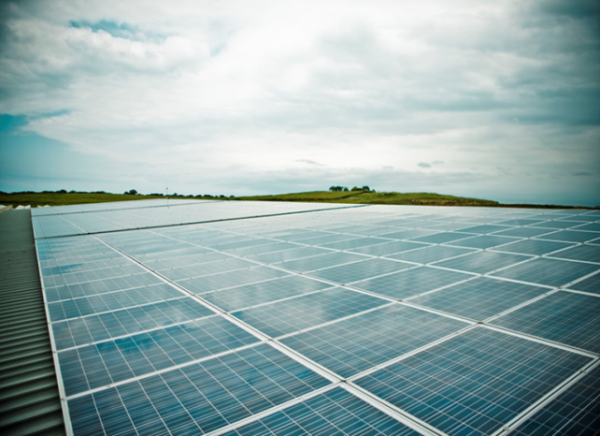
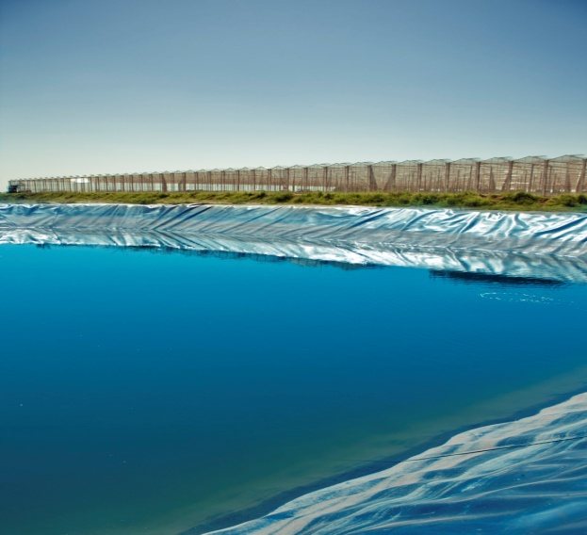
SUSTAINABLE FARMING INITIATIVES/ GREEN INITIATIVES
  Solar Energy
    702 Kw installation
  Rainwater Harvesting
  Recycling & re use of water
    Recycle all drainwater from greenhouses
    Re-use all flushed water from greenhouse and water treatment works
  Re use of green waste for composting
    300 m3 of green waste from the greenhouses transferred to a farm and converted into compost
  Accreditations to validate principles – Fair trade, retailer standards, ISO, etc

Slide 22
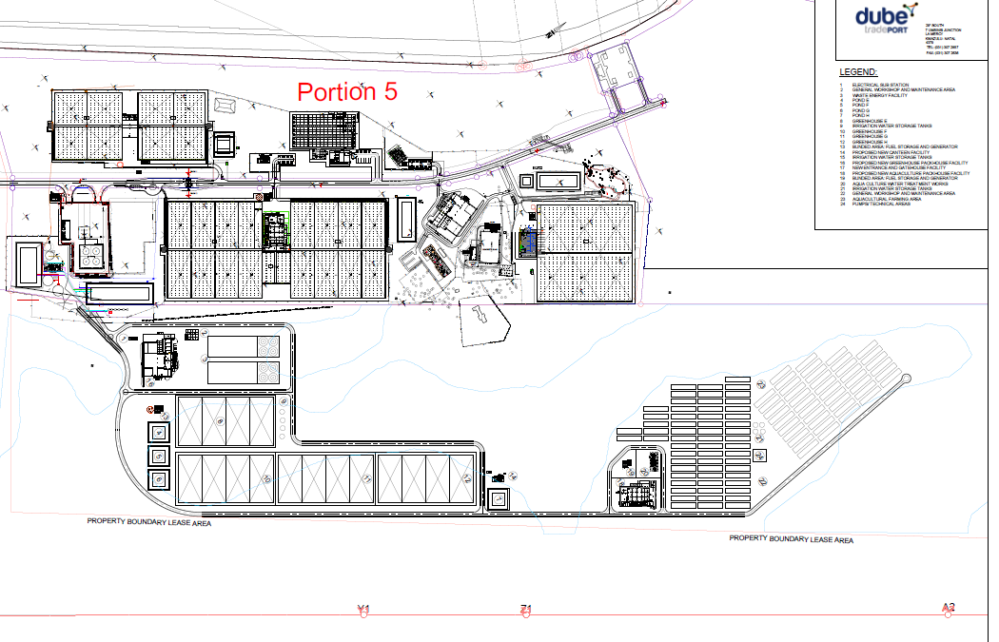
AGRIZONE PHASE 2 EXPANSION
Call for Proposals issued
90 hectare site for:
  Production facilities – plastic greenhouses, tunnels, shade houses, open
  Packhouses
  Processing and distribution
  High value air freight products e.g. aquaculture
  Renewable Energy utilising waste (feasibility underway with Private sector and academic institution)
Evaluation of first submissions underway
EIA process underway

Slide 23
CONCLUSION – Building Cargo Value Chain at Dube TradePort through various zones
Shippers / Manufacturers / Producers
Freight Forwarders & Logistics Service providers
Cargo Terminal Operations
Airlines, Trucking Network

Slide 24
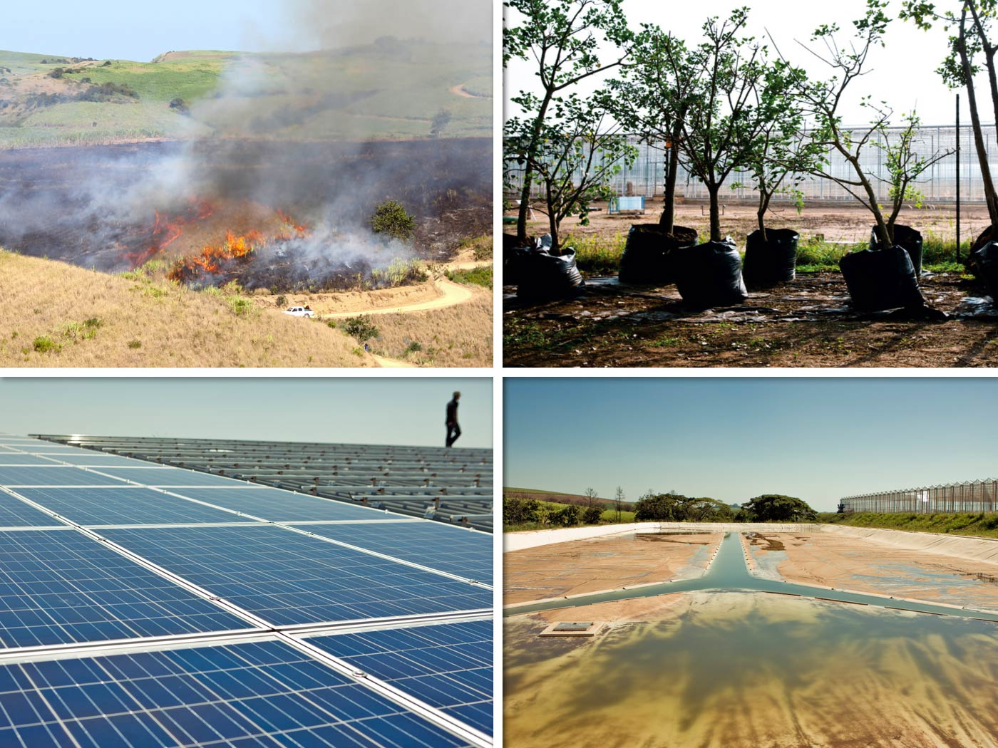
GREEN INITIATIVES
Include: alien clearing, indigenous nursery, rainwater harvesting and solar panels

Slide 25
THANK YOU
SIYABONGA
QUESTIONS

